Slide 1
Queue Management System for Campus Election in University of Technology, Malaysia
Ainal Farhan ; azmil azizi ; ridzwan syah ; faiz hakimi

Slide 2
Objective
The aims of this project is to execute campus elections in university with more manageable and time-savvy way. The project that we are proposing are mainly based on the listed objectives below :-
Ensuring orderly flow of voters in taking turns for voting process
Making sure that queuing does left students unoccupied
Decreasing the crowd area

Slide 3
Project Title : Queue Management System for Campus Election in University of Technology, Malaysia
Domain : Data Structure and Algorithm – Queue

Slide 4
Problem Statement
Taking turns for voting are usually cause time inefficiency and crowded environment.

Slide 5
Project description
The system to be developed is on Queue Management. In this system, we are implementing queue using linked lists. There will be 2 users of the system, the election officer and the voter. The election officers should be able to facilitate the queueing process while have full knowledge of the system control. In the other hand, the voters should be able to key in details in the Queue Management System.
When the voter first arrives for voting, the election officers will brief the procedures of queuing using the proposed system. Voters will then be instructed to key in details. The voter’s details will be used for turn taking, and data recording. If the queue is full, the voters will be able to key in their details in advance and when their turn is up, they will be notified to show up.

Slide 6
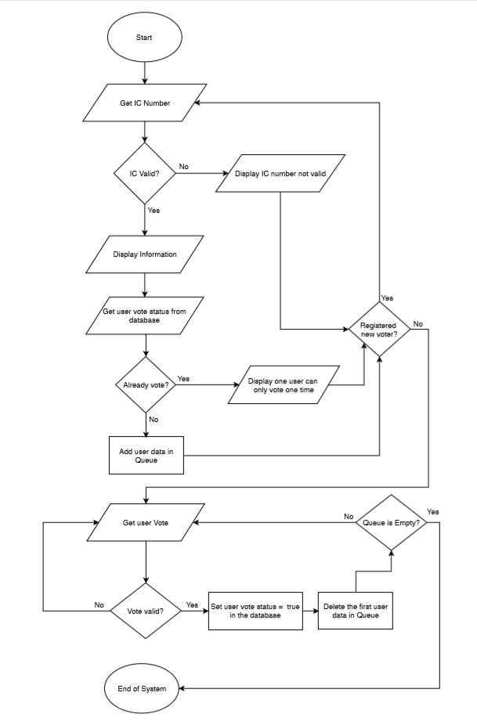
FLOWCHART

Slide 7
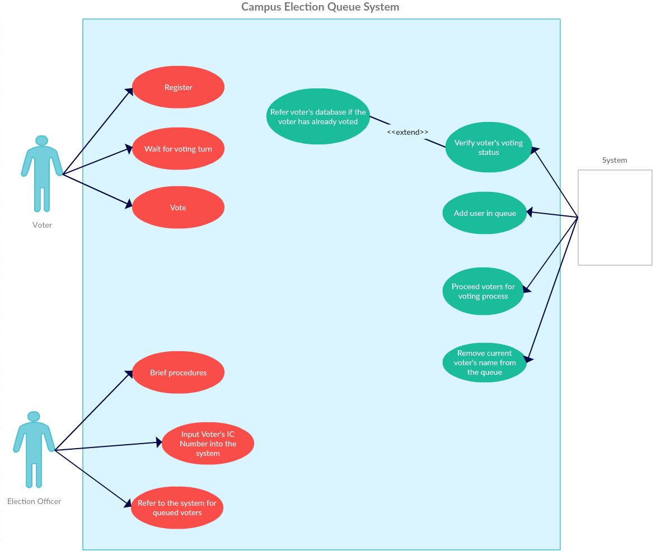
Case diagram

Slide 8
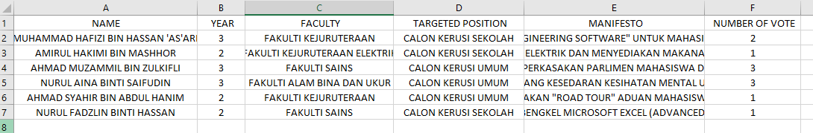
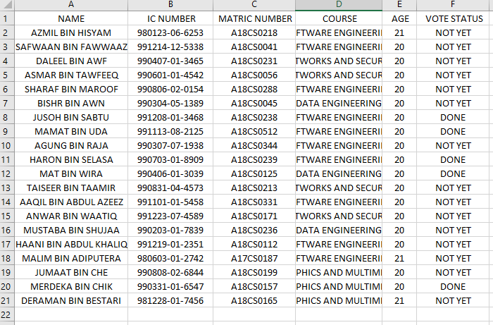
How it works?
Candidate.csv is made to store all the candidate data that compete in the election. It also store the amount of vote that the candidate have to make the voting counting session become more easy.
Database.csv – The function of this data is to represent the voter(student) in the system and act as UTM Database which use to store all the student data. It also can show if the student have vote for the election or not.

Slide 9
The program flow

Slide 10
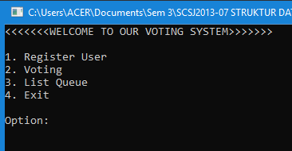
Main program
Main menu of the Voting System

Slide 11
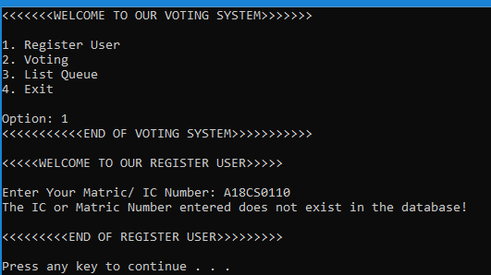
1. Registering non-student
Entering the Matric/ IC number which does not exist in the database

Slide 12
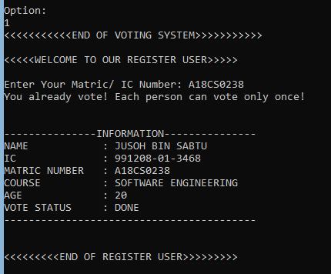
2. REGISTERING STUDENT THAT HAS VOTED
Entering the Matric/ IC Number user who already done their voting.

Slide 13
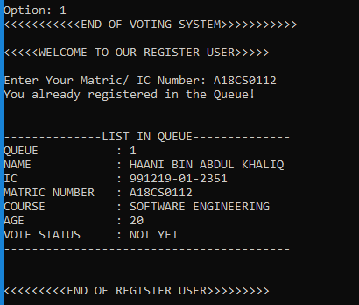
3. REGISTERING STUDENT THAT ALREADY REGISTERED
Display the current Queue Information

Slide 14
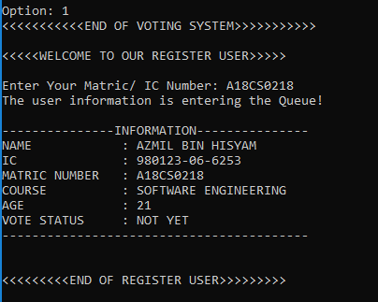
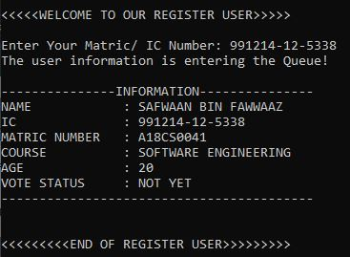
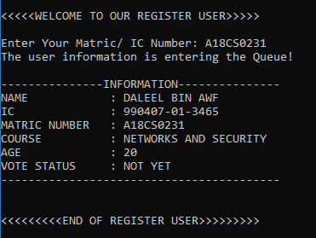
4. Register student to vote
User may enter Matric/ IC Number

Slide 15
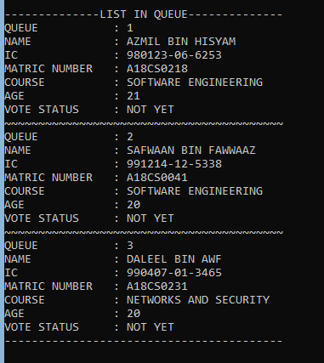
5.Check the queue

Slide 16
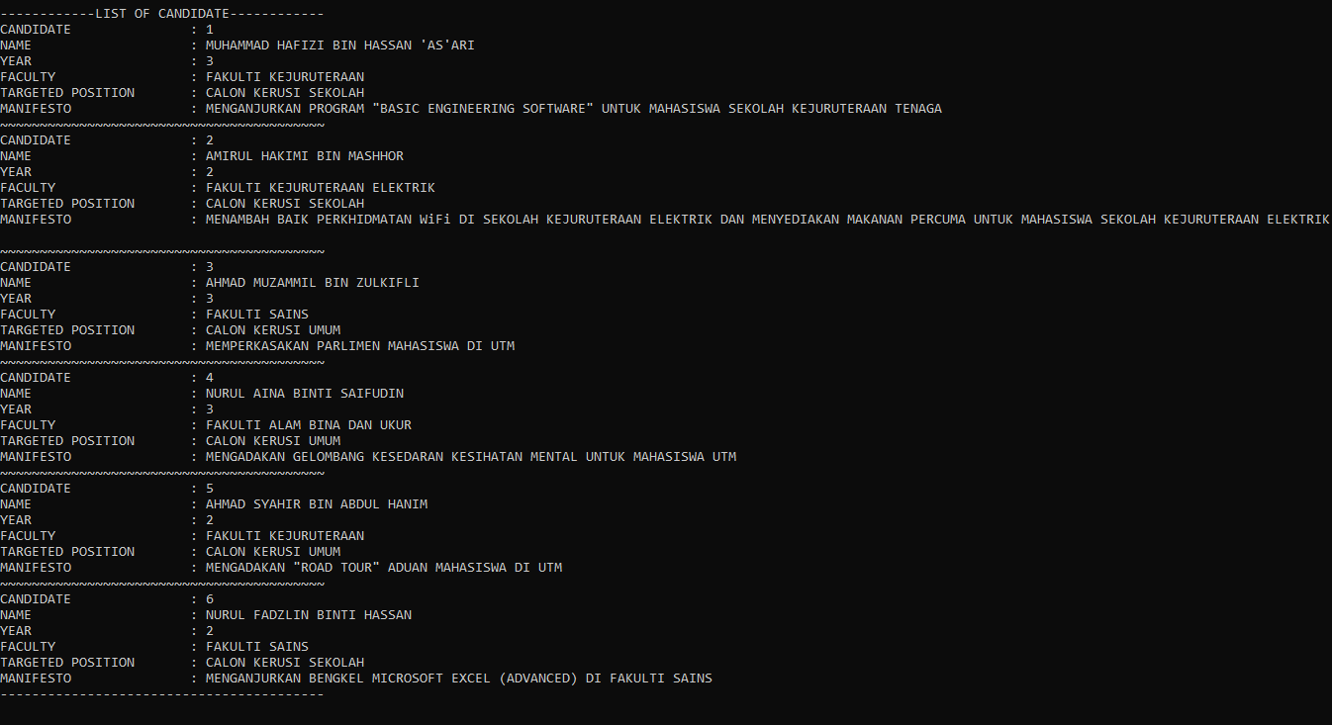
6.voting
CANDIDATE
NAME
YEAR
FACULTY
TARGETED POSITION
MANIFESTO

Slide 17

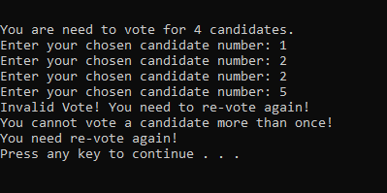
6.2 INVALID VOTING
The candidate number range from 1 to 6 only
There is a repetitive candidate number 2. So, the vote become invalid

Slide 18
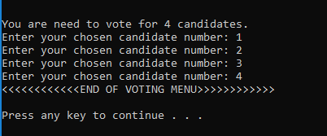
6.3 VALID VOTING
No repetitive votes
All votes within 1 to 6.

Slide 19
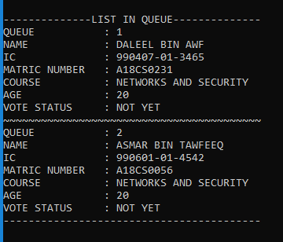
7. CHECK QUEUE and continue voting

Slide 20
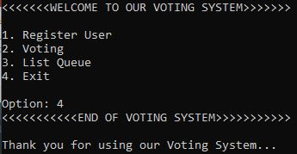
8. exit

Slide 21
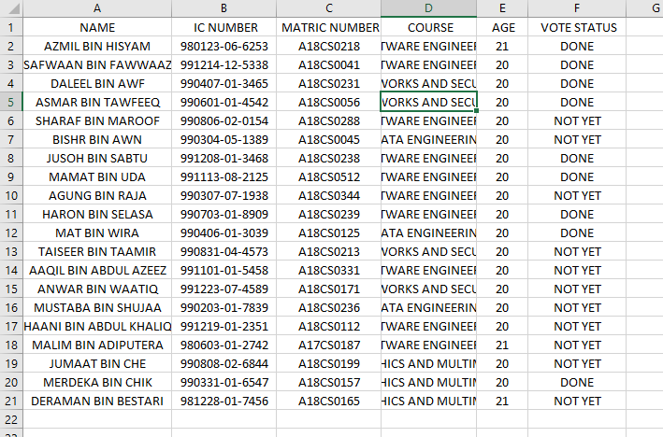
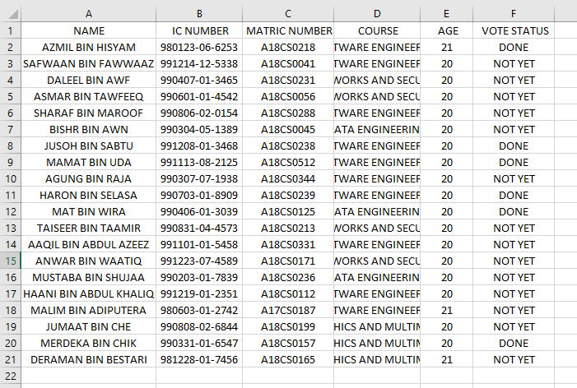
9. DATA Comparison (database.csv)
AFTER
BEFORE

Slide 22
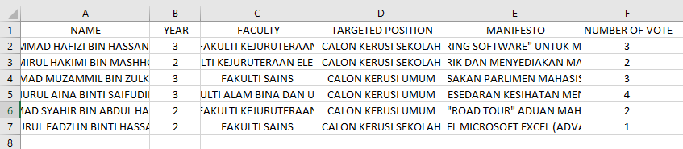
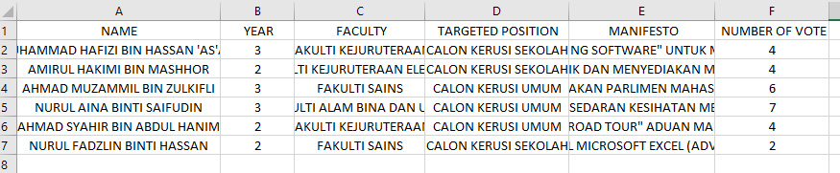
10. DATA Comparison (candidate.csv)
BEFORE
AFTER

Slide 23
Thank you

